Slide 1
CENTRALITY MEASURES
MASSIVE GRAPH MANAGEMENT & ANALYTICS
Shubekova Altynay
Karimova Laura

Slide 2
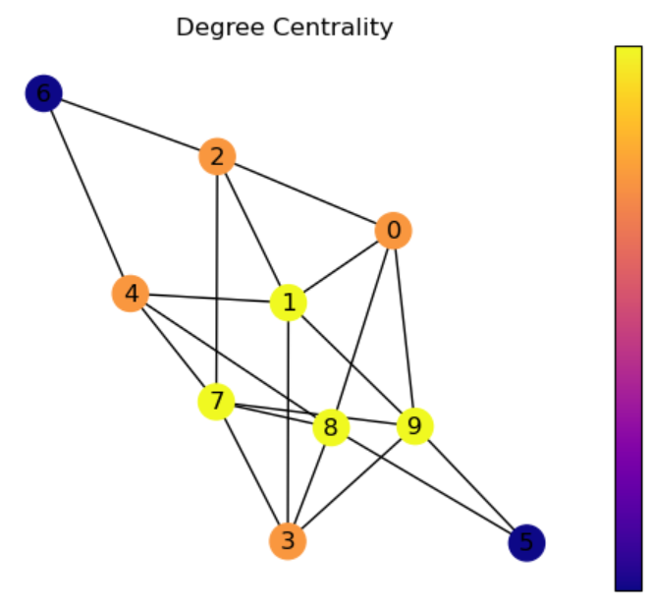
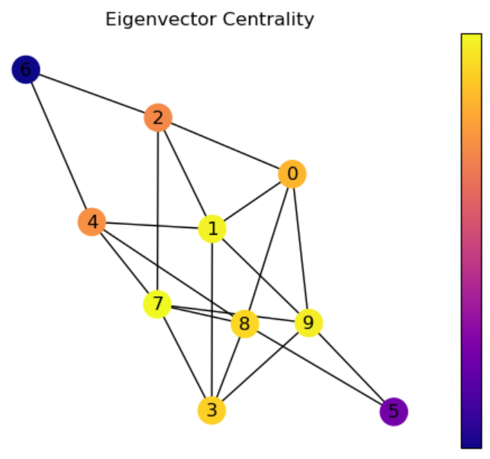
First dataset

Slide 3
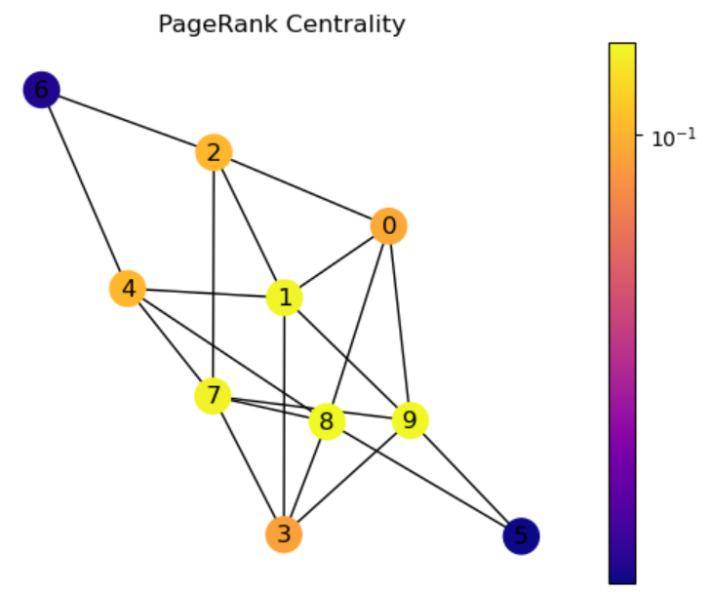
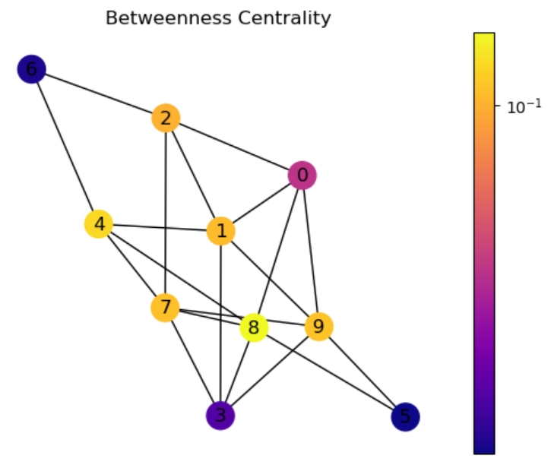
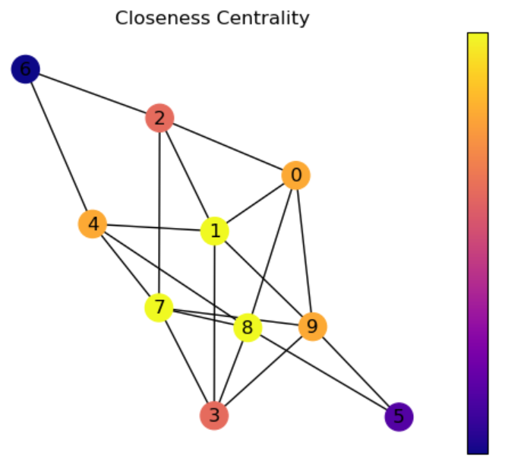

Slide 4
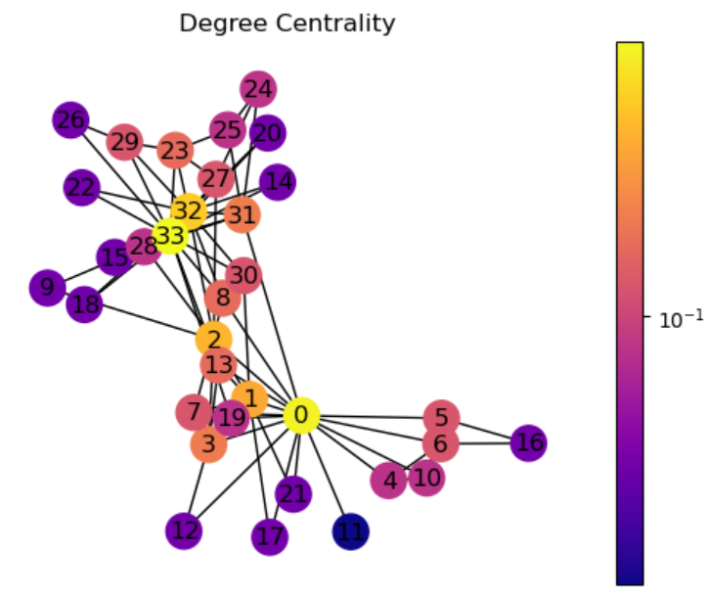
First dataset
Second dataset

Slide 5
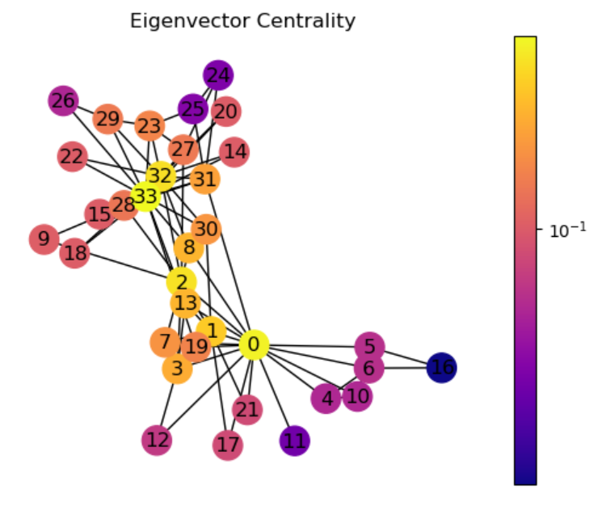
First dataset
Second dataset

Slide 6
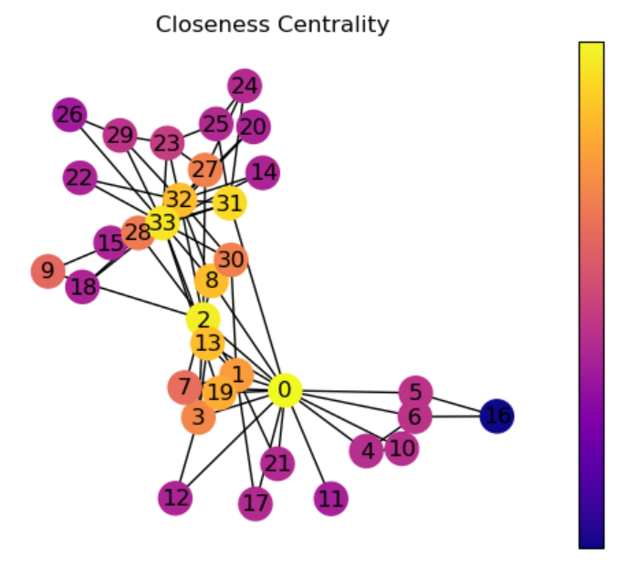
First dataset
Second dataset

Slide 7
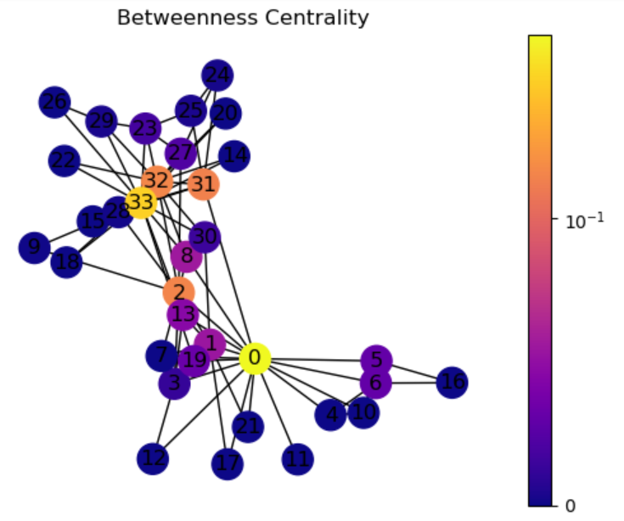
First dataset
Second dataset

Slide 8
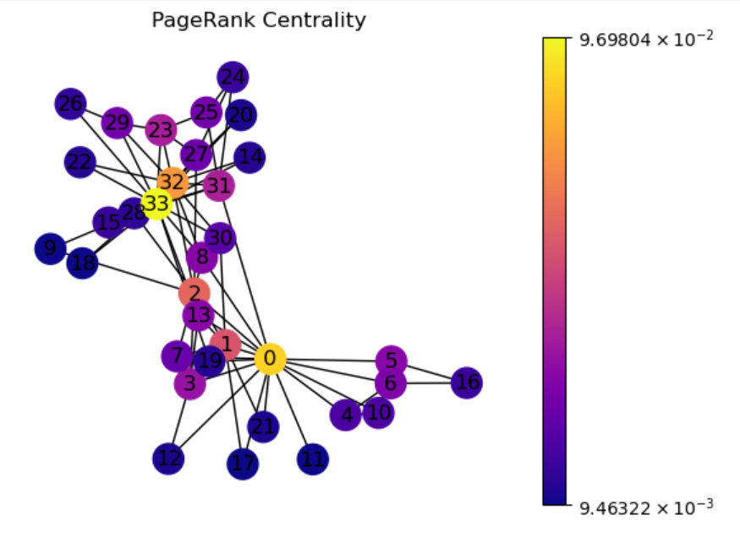
First dataset
Second dataset

